Slide 1









My Number Interactive Notebook
$$×$$
$$\frac{1}{2}$$
$$÷$$
$$+$$
$$−$$
$$\frac{3}{5}$$
$$7$$
Name
Class
Teacher
Term 1 Semester 1
$$5^{2}$$
$$\sqrt{9}$$
1

Slide 2
Contents
Glossary or Formula Page
Page
Date
Description
2
3

Slide 3
Tasks
24
7
30
Essential Question
Questions
Notes
Summary
10
11

Slide 4
24
7
30
Date
Scientific Notation
EQ – How is index notation used to write very large and small numbers?
11

Slide 5
24
7
30
Date
Scientific Notation
EQ – How is index notation used to write very large and small numbers?
What is scientific notation?
Examples
Is written as a number between 1 and 10 multiplied by a power of 10.
11

Slide 6
24
7
30
Date
Scientific Notation
EQ – How is index notation used to write very large and small numbers?
What is scientific notation or standard form?
Examples
Is written as a number between 1 and 10 multiplied by a power of 10.
Write 2 778 000 in scientific notation.
11

Slide 7
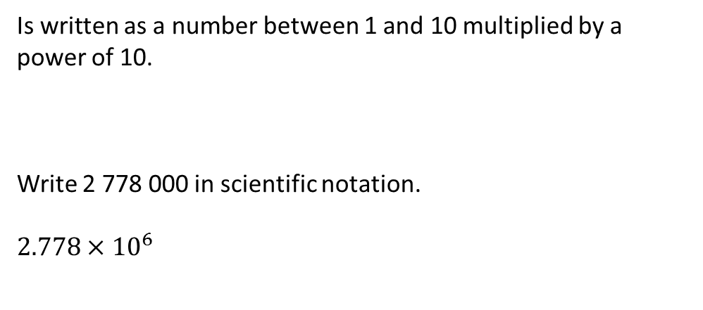
24
7
30
Date
Scientific Notation
EQ – How is index notation used to write very large and small numbers?
What is scientific notation or standard form?
Examples
Is written as a number between 1 and 10 multiplied by a power of 10.
Write 2 778 000 in scientific notation.
$$2.778×{10}^{6}$$
11

Slide 8
24
7
30
Date
Scientific Notation
EQ – How is index notation used to write very large and small numbers?
What is scientific notation or standard form?
Examples
Is written as a number between 1 and 10 multiplied by a power of 10.
Write 2 778 000 in scientific notation.
$$2.778×{10}^{6}$$
The number of digits past the first digit
11

Slide 9
24
7
30
Date
Scientific Notation
EQ – How is index notation used to write very large and small numbers?
What is scientific notation or standard form?
Examples
Is written as a number between 1 and 10 multiplied by a power of 10.
Write 2 778 000 in scientific notation.
$$2.778×{10}^{6}$$
The number of digits past the first digit
Write 0.0000073 in scientific notation.
11

Slide 10
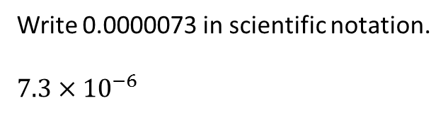
24
7
30
Date
Scientific Notation
EQ – How is index notation used to write very large and small numbers?
What is scientific notation or standard form?
Examples
Is written as a number between 1 and 10 multiplied by a power of 10.
Write 2 778 000 in scientific notation.
$$2.778×{10}^{6}$$
The number of digits past the first digit
Write 0.0000073 in scientific notation.
$$7.3×{10}^{−6}$$
11

Slide 11
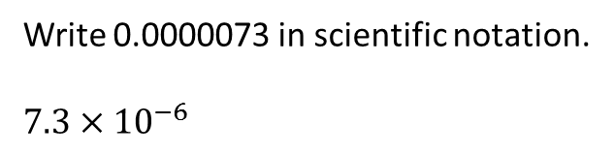
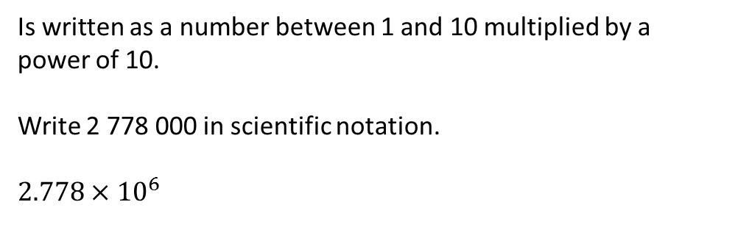
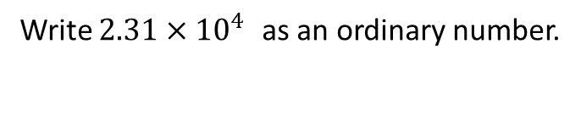
24
7
30
Date
Scientific Notation
EQ – How is index notation used to write very large and small numbers?
What is scientific notation or standard form?
Examples
Is written as a number between 1 and 10 multiplied by a power of 10.
Write 2 778 000 in scientific notation.
$$2.778×{10}^{6}$$
The number of digits past the first digit
Write 0.0000073 in scientific notation.
$$7.3×{10}^{−6}$$
The number places the decimal point moves
Write $2.31×{10}^{4 }$as an ordinary number.
11

Slide 12
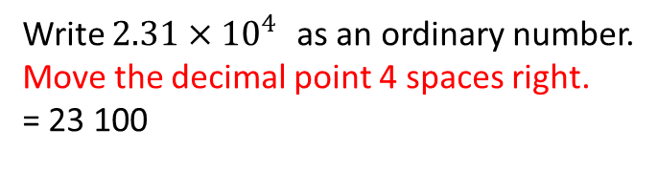
24
7
30
Date
Scientific Notation
EQ – How is index notation used to write very large and small numbers?
What is scientific notation or standard form?
Examples
Is written as a number between 1 and 10 multiplied by a power of 10.
Write 2 778 000 in scientific notation.
$$2.778×{10}^{6}$$
The number of digits past the first digit
Write 0.0000073 in scientific notation.
$$7.3×{10}^{−6}$$
The number places the decimal point moves
Write $2.31×{10}^{4 }$as an ordinary number.
Move the decimal point 4 spaces right.
= 23 100
11

Slide 13
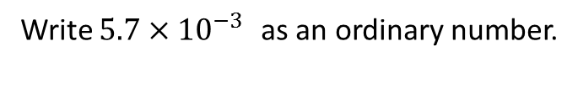
24
7
30
Date
Scientific Notation
EQ – How is index notation used to write very large and small numbers?
What is scientific notation or standard form?
Examples
Is written as a number between 1 and 10 multiplied by a power of 10.
Write 2 778 000 in scientific notation.
$$2.778×{10}^{6}$$
The number of digits past the first digit
Write 0.0000073 in scientific notation.
$$7.3×{10}^{−6}$$
The number places the decimal point moves
Write $2.31×{10}^{4 }$as an ordinary number.
Move the decimal point 4 spaces right.
= 23 100
Write $5.7×{10}^{−3 }$as an ordinary number.
11

Slide 14
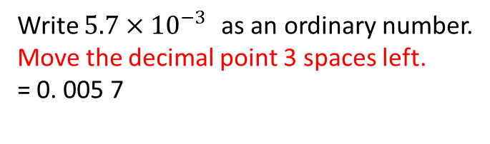
24
7
30
Date
Scientific Notation
EQ – How is index notation used to write very large and small numbers?
What is scientific notation or standard form?
Examples
Is written as a number between 1 and 10 multiplied by a power of 10.
Write 2 778 000 in scientific notation.
$$2.778×{10}^{6}$$
The number of digits past the first digit
Write 0.0000073 in scientific notation.
$$7.3×{10}^{−6}$$
The number places the decimal point moves
Write $2.31×{10}^{4 }$as an ordinary number.
Move the decimal point 4 spaces right.
= 23 100
Write $5.7×{10}^{−3 }$as an ordinary number.
Move the decimal point 3 spaces left.
= 0. 005 7
11

Slide 15
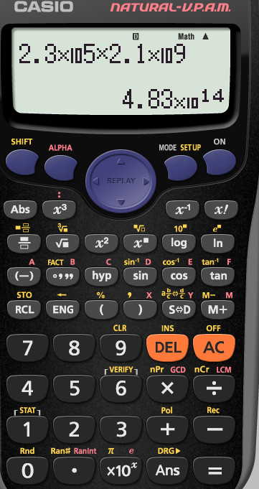
Some calculators use
EXP
Use for scientific notation

Slide 16
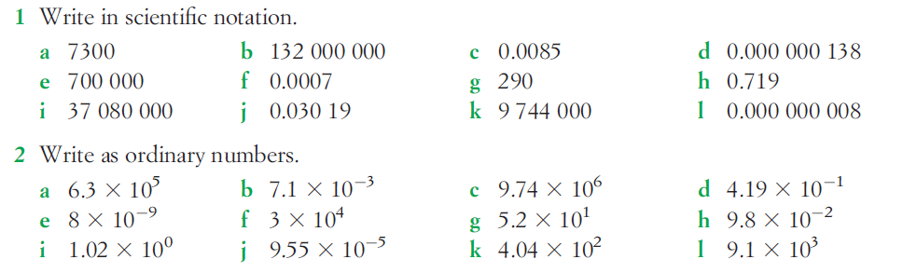

Slide 17
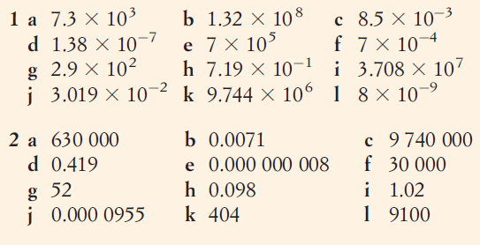
Answers

Slide 18
Notes Review
24, 7 ,30
Date
Title
Essential question
Notes complete
Notes complete with colour and diagrams
Questions completed
Contents page filed in
Formula page filled in

Slide 19
Homework
Review your notes and write a summary answering the essential question.

